Slide 1
Terrain Erosion in Voxels CGT 620 checkpoint 1
Yuanpei Zhao
zhao1023@purdue.edu

Slide 2
Expected Result
Use three pre-generated scenes
Only two types of material – hard and sand.
Initialize water with a fixed initial state
Implement shallow water simulation using voxel on GPU
Render voxels by OpenGL
Outcome: A real-time water simulation over a fixed terrain without erosion

Slide 3
3 Steps
Initialization
Simulation
Rendering
Read height image
Set voxel on GPU
Init OpenGL
Generate height map
Do water simulation
Modify voxel
Ray marching by CUDA
Render to screen by OpenGL

Slide 4
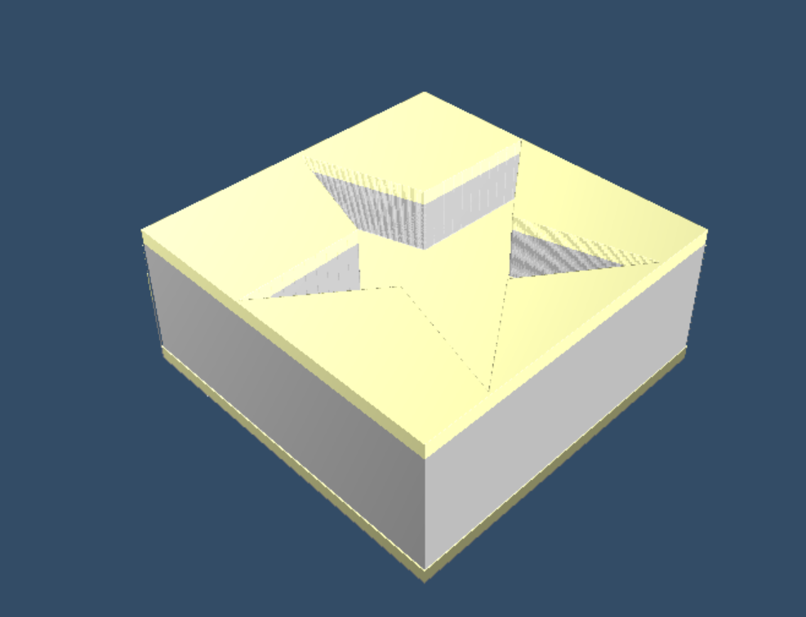
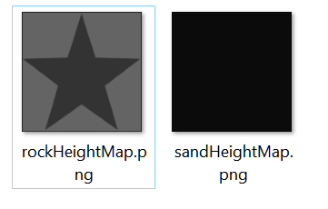

Initialization
Set on GPU a ${1024}^{3}∗unsigned char$ voxel
0 for empty, 1 for water, 2,3,… for different materials

Slide 5


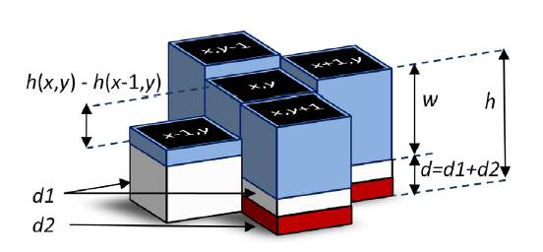


Simulation
Generate water height and material height from voxel for each column
After calculation, modify voxels on GPU memory
Synchronization

Slide 6


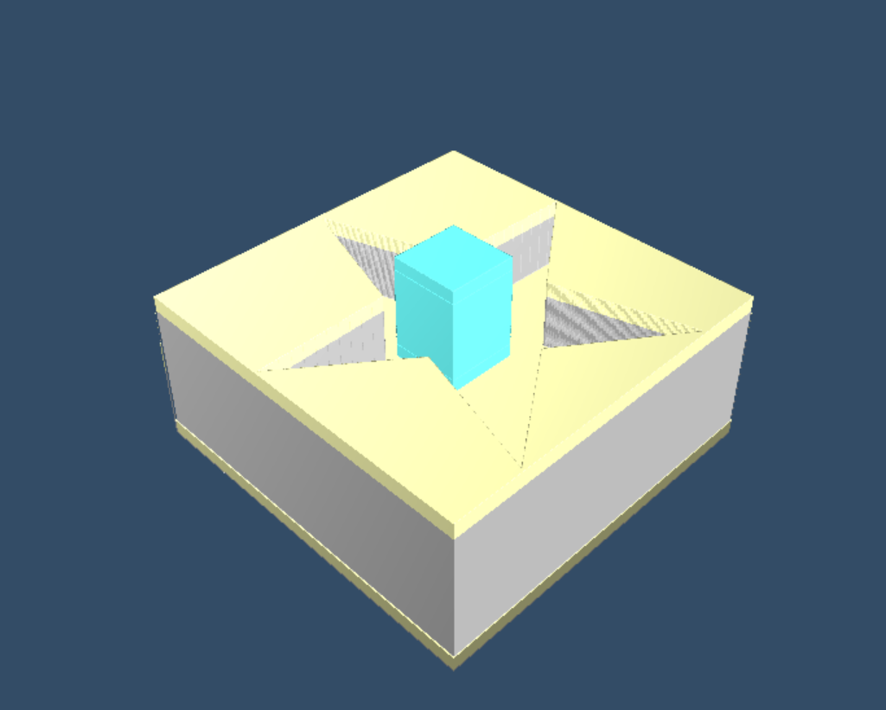
Rendering
Render front face &
back face position to texture
Get ray start point & end point
Do ray marching
OpenGL
CUDA
PBO
glDrawPixel
Calculate color for each screen pixels
*glfw does not support

Slide 7
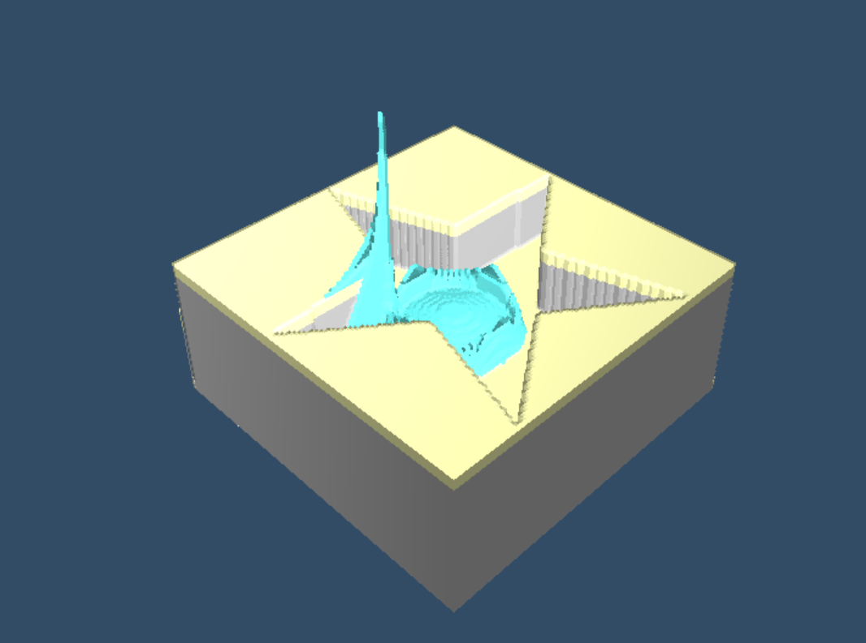
Result
A real-time water simulation over a fixed terrain without erosion
Problems to be solved:
Boundary condition bugs in water simulation
Reading voxels from global memory is slow

